Slide 1
By:- Amar Kumar Vishwakarma Resham Kumari
Capstone Project
Airline Passenger Referral Prediction

Slide 2
Project Name - Airline Passenger Referral Prediction
Project Type - Classification
Contribution - Team
Team Member 1 - - Amar Kumar Vishwakarma
Team Member 2 - - Resham Kumari
Project Summary -
Data includes airline reviews from 2006 to 2019 for popular airlines around the world withmultiple choice and free text questions. Data is scraped in Spring 2019. The
main objectiveis to predict whether passengers will refer the airline to their friends.
Feature descriptions briefly as follows:
*airline *: Name of the airline.
overall : Overall point is given to the trip between 1 to 10.
author : Author of the trip
review date : Date of the Review
customer review : Review of the customers in free text format

Slide 3
aircraft : Type of the aircraft
traveller type : Type of traveler (e.g. business, leisure)
cabin: Cabin at the flight date flown : Flight date
seat comfort : Rated between 1-5 cabin service : Rated between 1-5 foodbev : Rated between 1-5 entertainment : Rated between 1-5
ground service : Rated between 1-5
value for money : Rated between 1-5 recommended : Binary, target variable. Objective :
The main objective is to predict whether passengers will refer the airline to their family or friends.
GitHub Link -
https://github.com/ashamar1511
Problem Statement
Which Traveller_type has more ratings?
Which type of Cabin has more recommendation?

Slide 4
Is it Solo Leisure worth for Money?
In Economy Class what is the average ratings of Food_bev and entertainment given by passenger? 5.Which cabin type has more service ratings?
Which cabin type has overall service ratings?
Which travellers_type has overall service ratings? 8.Which airline made highest trips?
9.Comparison of all independent variable/features?
General Guidelines : -
Well-structured, formatted, and commented code is required.
Exception Handling, Production Grade Code & Deployment Ready Code will be a plus. Those students will be awarded some additional credits.
The additional credits will have advantages over other students during Star Student selection.
[ Note: - Deployment Ready Code is defined as, the whole .ipynb notebook should be executable in one go without a single error logged. ]
Each and every logic should have proper comments.
You may add as many number of charts you want. Make Sure for each and every chart the following format should be answered.
# Chart visualization code

Slide 5
Why did you pick the specific chart?
What is/are the insight(s) found from the chart?
Will the gained insights help creating a positive business impact? Are there any insights that lead to negative growth? Justify with specific reason.
5. You have to create at least 20 logical & meaningful charts having important insights.
[ Hints : - Do the Vizualization in a structured way while following "UBM" Rule. U - Univariate Analysis,
B - Bivariate Analysis (Numerical - Categorical, Numerical - Numerical, Categorical - Categorical) M - Multivariate Analysis ]
Let's Begin !
1. Know Your Data
Import Libraries
# Import Libraries # Import Libraries import numpy as np import pandas as pd
import matplotlib.pyplot as plt import seaborn as sns
%matplotlib inline import lightgbm

Slide 6
import warnings
warnings.filterwarnings('ignore')
# Importing all models from sklearn to be used in our model building from sklearn.linear_model import LogisticRegression
from sklearn.ensemble import RandomForestClassifier from sklearn.tree import DecisionTreeClassifier
from sklearn.neighbors import KNeighborsClassifier from sklearn.preprocessing import LabelEncoder
from sklearn.svm import SVC
from sklearn.naive_bayes import GaussianNB
from sklearn import model_selection
from sklearn.model_selection import train_test_split from sklearn.model_selection import GridSearchCV
from sklearn.svm import LinearSVC import time
from statsmodels.stats.outliers_influence import variance_inflation_factor from sklearn.naive_bayes import MultinomialNB
# Importing metrics for evaluation for our models from sklearn import metrics
from sklearn.metrics import classification_report,confusion_matrix from sklearn.metrics import accuracy_score,precision_score
from sklearn.metrics import recall_score,f1_score,roc_curve,roc_auc_score
Dataset Loading
# Load Dataset
from google.colab import drive drive.mount('/content/drive')

Slide 7

Mounted at /content/drive
airline_df = pd.read_excel('/content/drive/MyDrive/AlmaBetter/Capstone Project Classification/Airlines Passengers Referral Predicti
Dataset First View
# Dataset First Look airline_df.head()
airline |  | overall | author | review_date | customer_review | aircraft | traveller_type | cabin | route | date_flown | seat_c
0 NaN |  | NaN | NaN | NaN | NaN | NaN | NaN | NaN | NaN | NaN
Turkish Christopher 8th May ^{âœ… Trip Verified} Economy ^{London to} 2019-05-01 1 _{Airlines} 7.0 _{Hackley 2019} | London to Izmir NaN Business _{Class} Izmir via _{00:00:00}
 |  |  |  |  | via Istanb... |  |  |  | Istanbul
2 | NaN | NaN | NaN | NaN | NaN | NaN | NaN | NaN | NaN | NaN
3 | Turkish Airlines | 2.0 | Adriana Pisoi | 7th May 2019 | âœ… Trip Verified | Istanbul to | NaN | Family Leisure ^{Economy} Class |  | Istanbul to | 2019-05-01
 |  |  |  |  | Bucharest. We ... |  |  |  | Bucharest
4 | NaN | NaN | NaN | NaN | NaN | NaN | NaN | NaN | NaN | NaN
00:00:00
airline_df.tail()

Slide 8
airline
overall
author
review_date
customer_review
aircraft
traveller_type
cabin
route
date_flown
seat
Kiev - London
19th May (Gatwick) in 2006 business class (in
...
131890
Ukraine International
NaN
Andriy Yesypenko
NaN
NaN NaN NaN
NaN
131891
NaN
NaN
NaN
NaN
NaN
NaN
NaN NaN NaN
NaN
Ukraine International
Volodya Bilotkach
29th April
2006
Several flights - KBP to AMS (3
times one way)...
131892
NaN
NaN
NaN NaN NaN
NaN
131893
NaN
NaN
NaN
NaN
NaN
NaN
NaN NaN NaN
NaN
Ukraine International
Kasper Hettinga
10th KBP-AMS with February UIA. Although it 2006 was a relatively...
131894
NaN
NaN
NaN NaN NaN
NaN
Dataset Rows & Columns count
# Dataset Rows & Columns count print(airline_df.columns)
rows=airline_df.shape[0]
columns=airline_df.shape[1]
print(f"the number of rows is {rows} and number of columns is {columns}")
Index(['airline', 'overall', 'author', 'review_date', 'customer_review', 'aircraft', 'traveller_type', 'cabin', 'route', 'date_flown',
'seat_comfort', 'cabin_service', 'food_bev', 'entertainment', 'ground_service', 'value_for_money', 'recommended'],
dtype='object')
the number of rows is 131895 and number of columns is 17
Dataset Information

Slide 9
# Dataset Info
airline_df.info()
<class 'pandas.core.frame.DataFrame'>
RangeIndex: 131895 entries, 0 to 131894
Data columns (total 17 columns):
# Column Non-Null Count Dtype
airline
overall
author
review_date
customer_review
aircraft
traveller_type
cabin
route
date_flown
seat_comfort
cabin_service
food_bev
entertainment
ground_service
value_for_money
recommended
65947 non-null
64017 non-null
65947 non-null
65947 non-null
65947 non-null
19718 non-null
39755 non-null
63303 non-null
39726 non-null
39633 non-null
60681 non-null
60715 non-null
52608 non-null
44193 non-null
39358 non-null
63975 non-null
64440 non-null
object float64 object object object object object object object object float64 float64 float64 float64 float64 float64 object
dtypes: float64(7), object(10) memory usage: 17.1+ MB
Duplicate Values
# Dataset Duplicate Value Count
print(airline_df.duplicated().sum())
70711
airline_df.isnull().sum()

Slide 10
airline overall author
review_date
customer_review
aircraft
traveller_type
cabin route
date_flown
seat_comfort cabin_service food_bev
entertainment ground_service
value_for_money
recommended dtype: int64
65948
67878
65948
65948
65948
112177
92140
68592
92169
92262
71214
71180
79287
87702
92537
67920
67455
Missing Values/Null Values
# Missing Values/Null Values Count
Total = airline_df.isnull().sum().sort_values(ascending = False) #total per column
missing_values = round(((airline_df.isnull().sum())*100)/airline_df.isnull().count().sort_values(ascending=False),2) #missing_value data frame.
missing_total_percentage = pd.concat([Total,missing_values],axis=1,keys = ['Total','Percentage'],sort=False).sort_values('Total',as missing_total_percentage

Slide 11
 | Total | Percentage
aircraft | 112177 | 85.05
ground_service | 92537 | 70.16
date_flown | 92262 | 69.95
route | 92169 | 69.88
traveller_type | 92140 | 69.86
entertainment | 87702 | 66.49
food_bev | 79287 | 60.11
seat_comfort | 71214 | 53.99
cabin_service | 71180 | 53.97
cabin | 68592 | 52.01
value_for_money | 67920 | 51.50
overall | 67878 | 51.46
recommended 67455 51.14
customer_review 65948 50.00
review_date 65948 50.00
author 65948 50.00
airline 65948 50.00
# Visualizing the missing values import missingno as msno
msno.bar(airline_df)

Slide 12
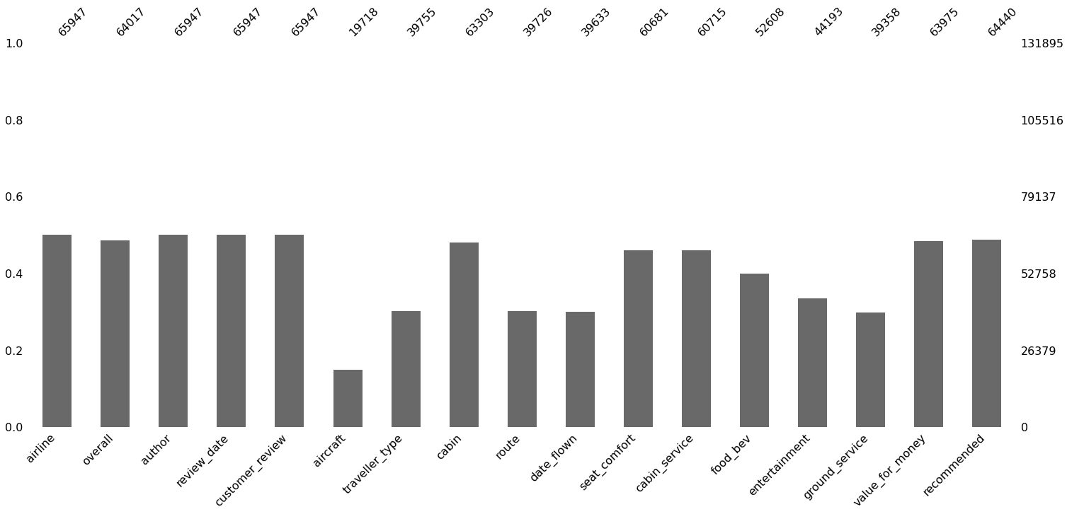
<AxesSubplot:>
What did you know about your dataset?
We can see that the dataset contains much more null values.

Slide 13

2. Understanding Your Variables
# Dataset Columns
print(airline_df.columns) columns=airline_df.shape[1]
print(f"The number of columns is {columns}.")
Index(['airline', 'overall', 'author', 'review_date', 'customer_review', 'aircraft', 'traveller_type', 'cabin', 'route', 'date_flown',
'seat_comfort', 'cabin_service', 'food_bev', 'entertainment', 'ground_service', 'value_for_money', 'recommended'],
dtype='object')
The number of columns is 17.
# Dataset Describe
airline_df.describe()
 | overall | seat_comfort | cabin_service | food_bev | entertainment | ground_service | value_for_money
count | 64017.000000 | 60681.000000 | 60715.000000 | 52608.000000 | 44193.000000 | 39358.000000 | 63975.000000
mean | 5.145430 | 2.952160 | 3.191814 | 2.908170 | 2.863372 | 2.692820 | 2.943962
std | 3.477532 | 1.441362 | 1.565789 | 1.481893 | 1.507262 | 1.612215 | 1.587370
min | 1.000000 | 1.000000 | 1.000000 | 1.000000 | 1.000000 | 1.000000 | 1.000000
25% | 1.000000 | 1.000000 | 2.000000 | 1.000000 | 1.000000 | 1.000000 | 1.000000
50% | 5.000000 | 3.000000 | 3.000000 | 3.000000 | 3.000000 | 3.000000 | 3.000000
75% | 9.000000 | 4.000000 | 5.000000 | 4.000000 | 4.000000 | 4.000000 | 4.000000
max | 10.000000 | 5.000000 | 5.000000 | 5.000000 | 5.000000 | 5.000000 | 5.000000

Slide 14
Variables Description
Here we described the data and got count, mean, std, min,percentile and max values.
Check Unique Values for each variable.
# Check Unique Values for each variable. airline_df.nunique(axis=0)
airline overall author
review_date
customer_review aircraft
traveller_type cabin
route
date_flown
seat_comfort
cabin_service food_bev
entertainment
ground_service value_for_money recommended
dtype: int64
81
10
44069
3015
61172
2088
4
4
24549
63
5
5
5
5
5
5
2
3. Data Wrangling
Data Wrangling Code

Slide 15
# Write your code to make your dataset analysis ready. def airline_dfinfo():
temp=pd.DataFrame(index=airline_df.columns) temp["datatype"]=airline_df.dtypes
temp["not null values"]=airline_df.count()
temp["null values"]=airline_df.isnull().sum()
temp["% of the null values"]=airline_df.isnull().mean() temp["unique count"]=airline_df.nunique()
return temp
airline_dfinfo()

Slide 16
datatype
not null values
null values
% of the null values
unique count
airline
object
65947
65948
0.500004
81
overall
float64
64017
67878
0.514637
10
author object 65947 65948 0.500004 44069
review_date object 65947 65948 0.500004 3015
What all manipulations have you done and insights you found?
We defined the informaton about the airline data and we found the datatypes of each rows. And also we found the not null values, null values, % of the null values.
4. Data Vizualization, Storytelling & Experimenting with charts : Understand the relationships between variables
seat_comfort float64 60681 71214 0.539929 5
Chart - 1
food_bev float64 52608 79287 0.601137 5
1. Which Traveller_type has more ratings?
customer_review object 65947 65948 0.500004 61172
aircraft object 19718 112177 0.850502 2088
traveller_type object 39755 92140 0.698586 4
cabin object 63303 68592 0.520050 4
route object 39726 92169 0.698806 24549
date_flown object 39633 92262 0.699511 63
cabin_service float64 60715 71180 0.539672 5
entertainment float64 44193 87702 0.664938 5
ground_service float64 39358 92537 0.701596 5
value_for_money float64 63975 67920 0.514955 5
recommended object 64440 67455 0.511430 2
# Chart - 1 visualization code plt.figure(figsize=(8,6))
sns.countplot(airline_df['traveller_type'])

Slide 17
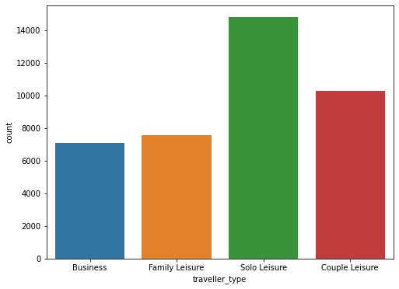
<AxesSubplot:xlabel='traveller_type', ylabel='count'>
Why did you pick the specific chart?
Because it is a univariate plot that shows the comparison of different groups in categorical variables. It shows the number of observations per category using bins.
What is/are the insight(s) found from the chart?
Travelling type of Solo Leisure has more ratings.
Will the gained insights help creating a positive business impact?
Are there any insights that lead to negative growth? Justify with specific reason.
↳ 1 cell hidden
Chart - 2

Slide 18
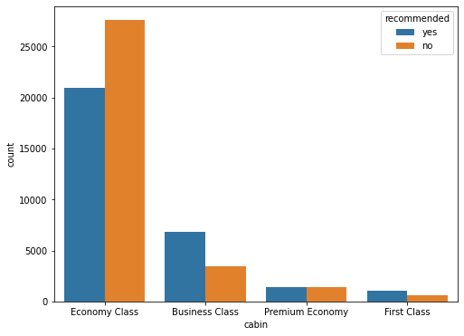
2. Which type of Cabin has more recommendation?
# Chart - 2 visualization code plt.figure(figsize=(8,6))
sns.countplot(airline_df['cabin'],hue=airline_df['recommended'])
<AxesSubplot:xlabel='cabin', ylabel='count'>
1. Why did you pick the specific chart?

Slide 19
Beacuse it is a univariate plot that shows the comparison of different groups in categorical variables. It shows the number of observations per category using bins.
2. What is/are the insight(s) found from the chart?
Economy class has the highest recommendation with bad reviews.
Business class has second most recommended cabin type with good reviews.
Premium economy has equal reviews.
First class is least recommended cabin type with good reviews.
3. Will the gained insights help creating a positive business impact?
Are there any insights that lead to negative growth? Justify with specific reason.
↳ 1 cell hidden
Chart - 3
3. Is Solo Leisure worth for money?
# Chart - 3 visualization code plt.figure(figsize=(8,6))
sns.barplot(x=airline_df['traveller_type'],y=airline_df['value_for_money'])

Slide 20
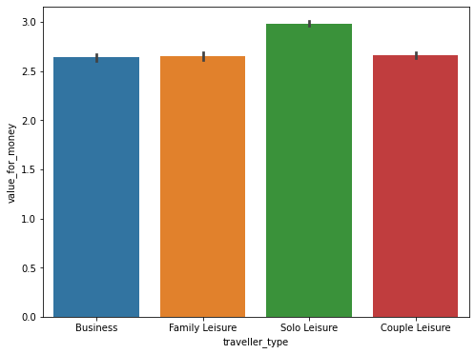
<AxesSubplot:xlabel='traveller_type', ylabel='value_for_money'>
Why did you pick the specific chart?
A barplot is one of the most common types of graphic. It shows the relationship between a numeric and a categoric variable.
What is/are the insight(s) found from the chart?
Yes, Travelling type Solo Leisure worth for money compare to others.
Will the gained insights help creating a positive business impact?
Are there any insights that lead to negative growth? Justify with specific reason.
↳ 1 cell hidden

Slide 21
4. In Economy Class what is the average ratings of Food_bev and entertainment given by passenger?
Chart - 4
# Chart - 4 visualization code
eda_4=airline_df.groupby('cabin')[['food_bev','entertainment']].mean().reset_index() eda_4
cabin | food_bev | entertainment
0 Business Class | 3.512540 | 3.354443
1 Economy Class | 2.756772 | 2.726349
2 First Class | 3.407602 | 3.301564
3 Premium Economy | 2.900616 | 3.012632
plt.rcParams['figure.figsize']=(10,7)
eda_4.plot(x="cabin",y=["food_bev","entertainment"],kind="bar")

Slide 22
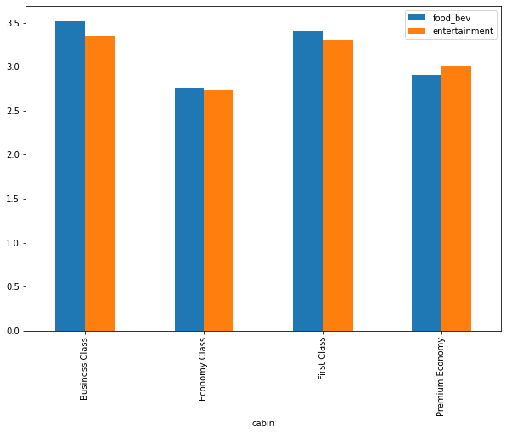
<AxesSubplot:xlabel='cabin'>
Why did you pick the specific chart?
Beacuse it is a univariate plot that shows the comparison of different groups in categorical variables. It shows the number of observations per category using bins.
What is/are the insight(s) found from the chart?
In Economy Class the average ratings of Food_bev and entertainment given by passenger is lowest compared to other cabin class.
Will the gained insights help creating a positive business impact?
Are there any insights that lead to negative growth? Justify with specific reason.

Slide 23
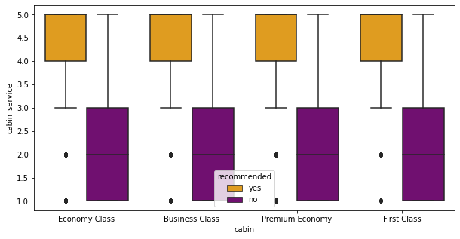
5. Which cabin type has more service ratings?
↳ 1 cell hidden
Chart - 5
# Chart - 5 visualization code plt.figure(figsize=(10,5))
sns.boxplot(airline_df.cabin, airline_df.cabin_service, hue=airline_df['recommended'], palette=['orange','purple'])
<AxesSubplot:xlabel='cabin', ylabel='cabin_service'>
1. Why did you pick the specific chart?

Slide 24
A boxplot is a method for graphically demonstrating the locality, spread and skewness groups of numerical data through their quartiles.
What is/are the insight(s) found from the chart?
First class travellers are least likely to recommended the airlines.
Recommendation is most probable when the cabin service is given full star rating i.e, 5 out of 5 here. In Economy class if we get ratings between 4 to 5 that means airlines recommended.
Will the gained insights help creating a positive business impact?
Are there any insights that lead to negative growth? Justify with specific reason.
↳ 1 cell hidden
Chart - 6
6. Which cabin type has overall service ratings?
# Chart - 6 visualization code plt.figure(figsize=(10,5))
sns.barplot(airline_df.cabin, airline_df.overall, hue = airline_df['recommended'],palette=['red','yellow'])

Slide 25
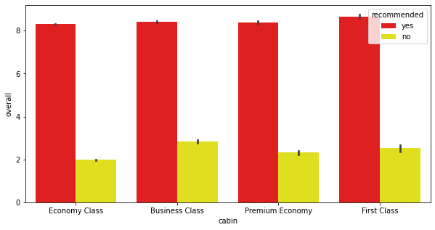
<AxesSubplot:xlabel='cabin', ylabel='overall'>
Why did you pick the specific chart?
A barplot is one of the most common types of graphic. It shows the relationship between a numeric and a categoric variable.
What is/are the insight(s) found from the chart?
If the trip is rated above 8 for overall section, the trip is most likely to be recommended by the travellers.
If it is below 3, the unhappy travellers has not referred the airlines to their friends irrespective of their cabin type.
Will the gained insights help creating a positive business impact?
Are there any insights that lead to negative growth? Justify with specific reason.
↳ 1 cell hidden
Chart - 7

Slide 26
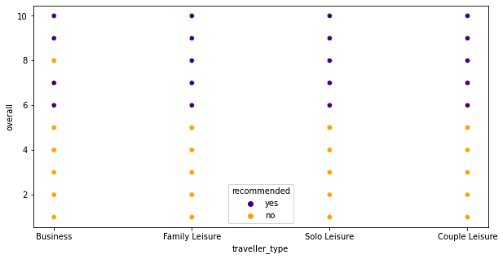
7. Which travellers_type has overall service ratings?
# Chart - 7 visualization code plt.figure(figsize=(10,5))
sns.scatterplot(airline_df.traveller_type, airline_df.overall, hue=airline_df['recommended'],palette=['indigo','orange'])
<AxesSubplot:xlabel='traveller_type', ylabel='overall'>
# Traveller type and value for money ratings (out of 5) plt.figure(figsize=(10,5))
sns.barplot(airline_df.traveller_type, airline_df.value_for_money, hue=airline_df['recommended'], palette=['blue','yellow'])

Slide 27
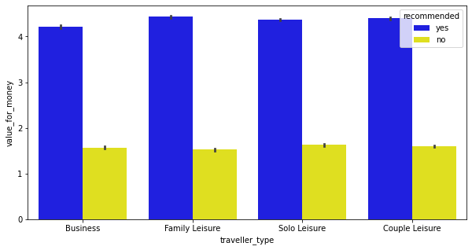
<AxesSubplot:xlabel='traveller_type', ylabel='value_for_money'>
Why did you pick the specific chart?
Graph 1 - A scatter plot uses dots to represent values for two different numeric variables.
Graph 2 - A barplot is one of the most common types of graphic. It shows the relationship between a numeric and a categoric variable.
What is/are the insight(s) found from the chart?
When the cabin_service is rated 5, it is highly likely that the reviewer has recommended the airlines to travel irrespective of the type of cabin.
Economy class is the most recommended cabin type, where as business class is the least recommended one.
Will the gained insights help creating a positive business impact?
Are there any insights that lead to negative growth? Justify with specific reason.
↳ 1 cell hidden

Slide 28
8. Which airline made highest trips?
Chart - 8
# Chart - 8 visualization code
# the number of trips each airline make.
trip_by_airlines = airline_df['airline'].value_counts() trip_by_airlines
Spirit Airlines
American Airlines United Airlines
British Airways
Cathay Pacific Airways
2934
2867
2829
2811
2402
...
105
85
80
71
48
QantasLink
Adria Airways Air Arabia
Tunisair
Thai Smile Airways
Name: airline, Length: 81, dtype: int64
plt.figure(figsize=(20,5))
trip_by_airlines[:10].plot(kind='bar',color='purple') plt.xlabel('Airline Type', fontsize=12)
plt.ylabel('Count',fontsize=12)
plt.title('Top 10 Airlines',fontsize=15) plt.xticks(rotation='horizontal')
plt.show()

Slide 29
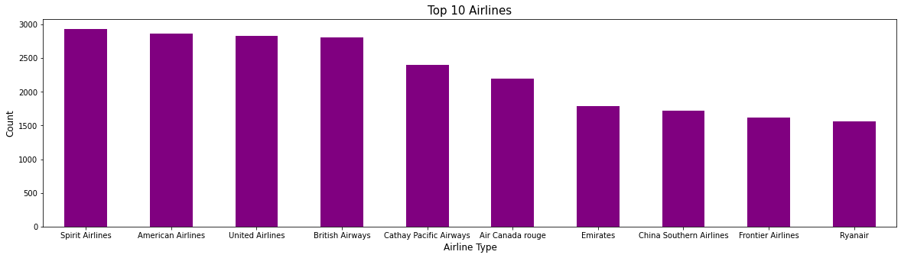
Why did you pick the specific chart?
A barplot is one of the most common types of graphic. It shows the relationship between a numeric and a categoric variable.
What is/are the insight(s) found from the chart?
We have observed that top 10 airlines with most trips are - Spirit Airlines
American Airlines British Airways
Emirates
China southern airline Frontier Airlines
Ryanair
Delta Airlines

Slide 30
Turklish Airlines
3. Will the gained insights help creating a positive business impact?
Are there any insights that lead to negative growth? Justify with specific reason.
↳ 1 cell hidden
Chart - 9
9. Comparison of all independent variable/features
# Chart - 9 visualization code
# frequency distribution using histogram
airline_df.hist(bins=50, figsize=(20,15), color = 'blue') plt.show()

Slide 31
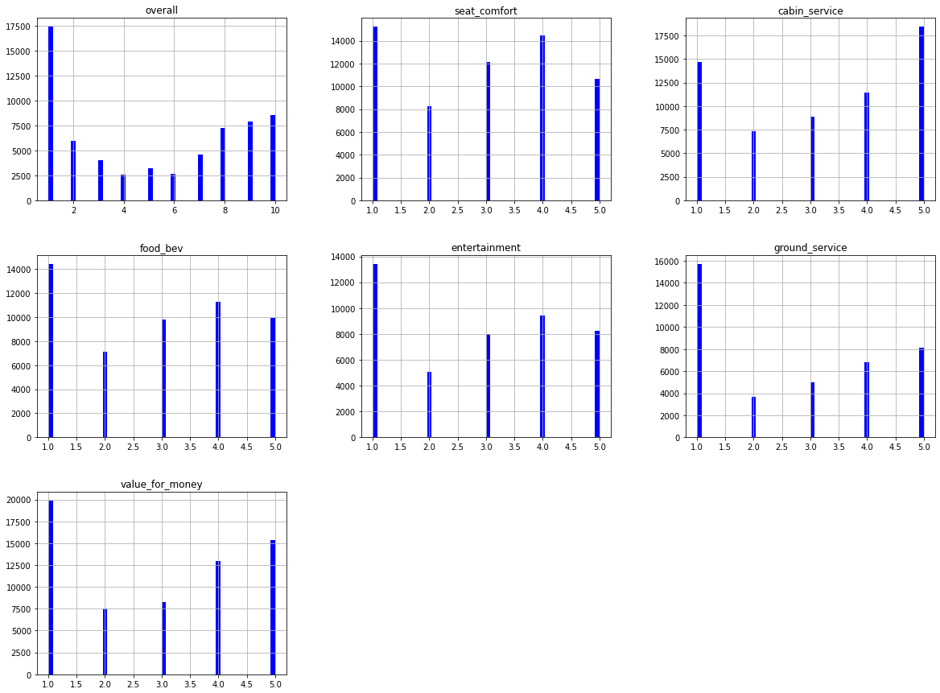
1. Why did you pick the specific chart?
A histogram is a graphical representation of the distribution of data. The histogram is represented by a set of rectangles, adjacent to each other, where each bar represent a kind of data.

Slide 32
2. What is/are the insight(s) found from the chart?
From the above plot:
The overall feature ratings of 1 to 2 occur more frequently.
From Seat comfort feature, We can say that rating of 1 is highest and rating of 4 is the second highest.
From cabin service feature, We can say that rating of 5 is highest and rating of 1 is the second highest.
The food bev feature ratings of 2,4 and 5 are varies equally.Which means their frequency are approximately equal.
The features of both the entertainment & ground service, We can say that ratings of 3 is highest and ratings of 1 is the second highest.
From value for money feature, It clearly shows that most of the passenger gives ratings of 1 as highest. From this we can say that most of the airline does not provide good service to passenger.
Dropping Unnecessary Columns
# Checking Percentage wise missing values. def missing_values_per_check(df):
percent_missing = airline_df.isnull().sum()*100 / len(airline_df)
missing_values_df = pd.DataFrame({'column_name': airline_df.columns,
'percent_missing': percent_missing}) return missing_values_df.sort_values('percent_missing',ascending=False)
# Checking Percentage wise missing values. missing_values_per_check(airline_df)

Slide 33
column_name
percent_missing
aircraft
aircraft
85.050229
ground_service
ground_service
70.159597
date_flown
date_flown
69.951097
route
route
69.880587
traveller_type
traveller_type
69.858600
entertainment
entertainment
66.493802
food_bev
food_bev
60.113727
seat_comfort
seat_comfort
53.992949
cabin_service
cabin_service
53.967171
cabin
cabin
52.005004
value_for_money
value_for_money
51.495508
overall
overall
51.463664
recommended
recommended
51.142955
customer_review
customer_review
50.000379
review_date
review_date
50.000379
author author
# Showing the unique aircraft names airline_df.aircraft.unique()
50.000379
airline airline 50.000379
array([nan, 'A330', 'Boeing 737-800 / A330-300', ...,
'Boeing 737-800 and Embraer 190', 'Boeing 737-400/ 737-800',
'boeing 767'], dtype=object)

Slide 34
# Checking the number of unique aircrafts airline_df.aircraft.nunique()
2088
Dropping the aircraft column from data as it have highest null values.
airline_df = airline_df.drop(['aircraft'],axis=1)
# dropping the cloumns from data which are not for our use
airline_df = airline_df.drop(['author','review_date','route','date_flown','customer_review'],axis = 1) airline_df.head()
airline |  | overall | traveller_type | cabin | seat_comfort | cabin_service | food_bev | entertainment | ground_service | value_for
0 NaN |  | NaN | NaN | NaN | NaN | NaN | NaN | NaN | NaN
1 | Turkish Airlines | 7.0 | Business | Economy Class | 4.0 | 5.0 | 4.0 | 4.0 | 2.0
2 | NaN | NaN | NaN | NaN | NaN | NaN | NaN | NaN | NaN
3
Turkish Airlines
2.0
Family Leisure
Economy
Class
4.0
1.0
1.0
1.0
1.0
Reason of dropping columns:-
Author - Being the categorical with high Variability not required for prediction.
Route - Not needed for building a model as it is independent of the Services and Quality of travel.
Date_flown - Not needed for building a model as it is not a time series data, also some common time period is there between 2 dates. Review_date - Similar to Date_flown
Customer_review - As it is related to overall review feature of the datasets.

Slide 35
On the basis of null value percentage we divide our data in to two parts -
high_null = Columns which have high percentage of null values. low_null = Columns which have low percentage of null values.
# Splitting the numeric column
low_null = ['overall','seat_comfort','cabin_service','value_for_money'] high_null = ['food_bev','entertainment','ground_service']
# Imputation technique using Quantile-1 value def impute_by_q1_values(df,column):
Q1=np.percentile(np.sort(df[column].dropna()),25) df[column].fillna(Q1,inplace=True)
# Loopping the null value column for col in low_null:
impute_by_q1_values(airline_df,col)
Imputed null values by Quantile-1 fro the columns have low null value percentage.
# Imputation technique using Median imputation def median_imputation(df,column):
df[column].fillna(df[column].median(),inplace=True)
# Looping the null value column for col in high_null:
median_imputation(airline_df,col)
Imputed null values by Median imputation for the columns have high percentage.

Slide 36
# After imputed null values airline_df.head(1)
airline overall traveller_type cabin seat_comfort cabin_service food_bev
NaN 1.0 NaN NaN 1.0 2.0 3.0
entertainment
ground_service
value_for_mo
0
3.0
3.0
Now we are left with null values in traveller_type, cabin, recommended column.
# Remove recommended null value row
airline_df.dropna(subset=['recommended'],inplace=True)
airline_df['traveller_type'].fillna(method="ffill",inplace=True)
airline_df['cabin'].fillna(airline_df['cabin'].mode().values[0],inplace=True)
Filling traveller_type column with Mode Imputation Cabin column with Forward fill method.
airline_df.head(1)
airline overall traveller_type
cabin seat_comfort cabin_service food_bev entertainment ground_service value_for
Turkish
Economy
# Checking the new null value percentage missing_values_per_check(airline_df)

Slide 37
 | column_name | percent_missing
airline | airline | 0.0
overall | overall | 0.0
traveller_type | traveller_type | 0.0
cabin | cabin | 0.0
seat_comfort | seat_comfort | 0.0
cabin_service | cabin_service | 0.0
food_bev | food_bev | 0.0
entertainment | entertainment | 0.0
ground_service | ground_service | 0.0
value_for_money | value_for_money | 0.0
airline_df.shape
(64440, 11)
# Converting targeted column
airline_df['recommended'].replace({'yes':1,'no':0},inplace=True)
recommended recommended 0.0
airline_df.head(2)
airline overall traveller_type
cabin seat_comfort
cabin_service food_bev entertainment ground_service value_for
5.0 4.0 4.0 2.0
1
Turkish Airlines
7.0
Business
Economy
Class
4.0
Chart - 10

Slide 38
# Chart - 10 visualization code plt.figure(figsize=(12,10))
sns.heatmap(airline_df.corr(),annot=True)

Slide 39
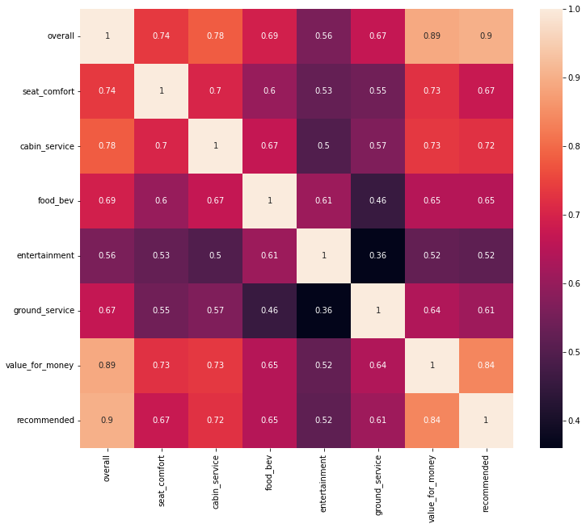
<AxesSubplot:>
Why did you pick the specific chart?
A heatmap is a graphical representation of data that uses a system of color-coding to represent different values.
What is/are the insight(s) found from the chart?
Drop overall column as it has highest correlation value than others.
Removing Multicollinearity features
# Creating a function to remove multicollinear def calc_vif(X):
# Calculating VIF
vif = pd.DataFrame()
vif["variables"] = X.columns
vif["VIF"] = [variance_inflation_factor(X.values,i) for i in range(X.shape[1])]
return(vif)
calc_vif(airline_df[[i for i in airline_df.describe().columns if i not in ['recommended','value_for_money','overall']]])

Slide 40
variables
VIF
0
seat_comfort
10.951034
1 cabin_service
13.238540
2 food_bev 12.842290
# Drop overall column
airline_df.drop(["overall"],axis = 1, inplace=True)
airline_df.drop(["airline"], axis=1, inplace=True)
Here we are dropping airline column from oour data as it is no usecase further.
3 entertainment 9.511114
4 ground_service 8.115697
Defining the dependent and independent variables
# Separating the dependent Nad independent variables y = airline_df['recommended']
x = airline_df.drop(columns = 'recommended')
x.columns
Index(['traveller_type', 'cabin', 'seat_comfort', 'cabin_service', 'food_bev', 'entertainment', 'ground_service', 'value_for_money'],
dtype='object')
One hot encoding

Slide 41
x = pd.get_dummies(x)
x.shape
(64440, 14)
x.head(2)
seat_comfort
cabin_service
food_bev
entertainment
ground_service
value_for_money
traveller_type_Business
traveller_
1
4.0
5.0
4.0
4.0
2.0
4.0
1
3
4.0
1.0
1.0
1.0
1.0
1.0
0
print("The Percentage of no labels of Target variables is",np.round(y.value_counts()[0]/len(y)*100)) print("The Percentage of Yes labels of Target Variable is",np.round(y.value_counts()[1]/len(y)*100))
The Percentage of no labels of Target variables is 53.0 The Percentage of Yes labels of Target Variable is 47.0
The percentage of both labels('yes','no') is approximately equal. So no need of handling class imbalance technique.
Splitting Train and Test Data
# train and test split
x_train, x_test, y_train, y_test = train_test_split(x,y,test_size=0.2,random_state=42)

Slide 42
# shape of x_train and x_test data print(x_train.shape)
print(x_test.shape)
(51552, 14)
(12888, 14)
# Shape of y_train and y_test data print(y_train.shape)
print(y_test.shape)
(51552,)
(12888,)
Model-1 :- Fitting Logistic Regression
# logistic regression fitting
log_reg = LogisticRegression(fit_intercept=True,max_iter=10000) log_reg.fit(x_train,y_train)
LogisticRegression(max_iter=10000)
log_reg.coef_
array([[ 0.12156446, | 0.56141512, | 0.46541611, | 0.29235549, | 0.73563495,
1.65749217, | 0.08577989, | -0.05202588, | -0.11451842, | 0.08281098,
0.12708132, | -0.09080577, | 0.14719719, | -0.18142616]])
log_reg.intercept_
array([-11.67281998])

Slide 43
log_reg.score(x_test,y_test)
0.9340471756672873
y_pred = log_reg.predict(x_test) # report of logistic regression
report_lR = classification_report(y_test,y_pred)
print(report_lR)
 | precision | recall | f1-score | support
0 | 0.95 | 0.93 | 0.94 | 6886
1 | 0.92 | 0.94 | 0.93 | 6002
accuracy |  |  | 0.93 | 12888
macro avg | 0.93 | 0.93 | 0.93 | 12888
weighted avg | 0.93 | 0.93 | 0.93 | 12888
93% accuracy with Logistic Regression
# confusion matrix of logistic regression
confuse_matrix_lr = confusion_matrix(y_test,y_pred) # plotting confusion matrix
sns.heatmap(confuse_matrix_lr, annot=True, fmt = ".1f")

Slide 44
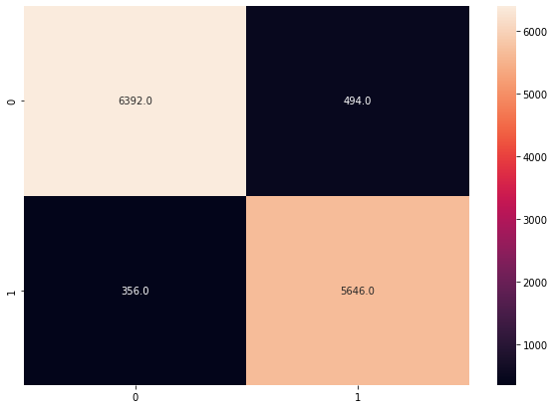
Implementing Cross-validated Logistic regression
<AxesSubplot:>
logistic = LogisticRegression()
from sklearn.model_selection import cross_val_score
scores = cross_val_score(log_reg, x_train, y_train, cv=10) print('Cross-Validation Accuracy Scores',scores)
Cross-Validation Accuracy Scores [0.94336695 0.93735454 0.9371484
0.93656644 0.93579049 0.93967022 0.9414161 ]
0.93928225 0.93094083 0.9371484
scores = pd.Series(scores)
scores.min(),scores.mean(),scores.max()
(0.9309408341416101, 0.9378684632106784, 0.943366951124903)

Slide 45
Model-2 :- Fitting Decision Tree Classifier
# Initializing Decison Tree Model object tree_classify=DecisionTreeClassifier()
# Training a model with x and y
tree_classify.fit(x_train,y_train)
DecisionTreeClassifier()
print("Training Accuracy of Decision Tree Model is",tree_classify.score(x_train,y_train)) print("Testing Accuracy of Decision Tree Model is",tree_classify.score(x_test,y_test))
Training Accuracy of Decision Tree Model is 0.974588764742396 Testing Accuracy of Decision Tree Model is 0.9243482309124768
y_pred = tree_classify.predict(x_test) #report of decision tree
report_dec_tree = classification_report(y_test,y_pred) print(report_dec_tree)
 | precision | recall | f1-score | support
0 | 0.93 | 0.93 | 0.93 | 6886
1 | 0.92 | 0.92 | 0.92 | 6002
accuracy |  |  | 0.92 | 12888
macro avg | 0.92 | 0.92 | 0.92 | 12888
weighted avg | 0.92 | 0.92 | 0.92 | 12888

Slide 46
Hyperparameter Tuning for Decision Tree
Here our model is Overfitted. So Hyperparameter tuning is to be done to prune a Decision Tree to preserve Generalized Model.
# setting the parameter and scoring metric
parameters = {"criterion":["gini","entropy"],"max_depth":[5,7],"min_samples_split":[5,7],"min_samples_leaf":[2,3]} scoring_ = ['f1','recall','precision','accuracy']
#performing hyperparameter tuning using gridsearchcv #setting an estimator and crossvalidation
tree_cv = GridSearchCV(estimator=tree_classify, param_grid=parameters, scoring=scoring_, cv=5,refit='accuracy')
#Fitting x and y to gridsearchcv model using an estimator Decision tree classifier tree_cv.fit(x_train, y_train)
GridSearchCV(cv=5, estimator=DecisionTreeClassifier(),
param_grid={'criterion': ['gini', 'entropy'], 'max_depth': [5, 7],
'min_samples_leaf': [2, 3],
'min_samples_split': [5, 7]},
refit='accuracy',
scoring=['f1', 'recall', 'precision', 'accuracy'])
#calling a best params tree_cv.best_params_
{'criterion': 'gini', 'max_depth': 7,
'min_samples_leaf': 3,
'min_samples_split': 5}

Slide 47
#calling a best score tree_cv.best_score_
0.9372284173644845
93% accuracy of Decision Tree with the help of hyperparameter tuning.
Model-3 :- Fitting Random Forest
random_forest = RandomForestClassifier() random_forest.fit(x_train,y_train)
RandomForestClassifier()
random_forest.score(x_test,y_test) 0.9349006828057107
# report of decision tree
report_ran_forest = classification_report(y_test,y_pred) print(report_ran_forest)
 | precision | recall | f1-score | support
0 | 0.93 | 0.93 | 0.93 | 6886
1 | 0.92 | 0.92 | 0.92 | 6002
accuracy |  |  | 0.92 | 12888
macro avg | 0.92 | 0.92 | 0.92 | 12888
weighted avg | 0.92 | 0.92 | 0.92 | 12888

Slide 48

Implementing Cross-validated Random Forest
92% accuracy with Random Forest
random_forest_gridcv = GridSearchCV(estimator=random_forest,
param_grid = parameters, cv = 5, verbose=2)
random_forest_gridcv.fit(x_train,y_train)

Slide 49
[CV] | END | criterion=entropy, | max_depth=5, | min_samples_leaf=3, | min_samples_split=5; | total | time= | 3.5s
[CV] | END | criterion=entropy, | max_depth=5, | min_samples_leaf=3, | min_samples_split=5; | total | time= | 3.2s
[CV] | END | criterion=entropy, | max_depth=5, | min_samples_leaf=3, | min_samples_split=5; | total | time= | 1.8s
[CV] | END | criterion=entropy, | max_depth=5, | min_samples_leaf=3, | min_samples_split=7; | total | time= | 2.6s
[CV] | END | criterion=entropy, | max_depth=5, | min_samples_leaf=3, | min_samples_split=7; | total | time= | 4.9s
[CV] | END | criterion=entropy, | max_depth=5, | min_samples_leaf=3, | min_samples_split=7; | total | time= | 2.8s
[CV] | END | criterion=entropy, | max_depth=5, | min_samples_leaf=3, | min_samples_split=7; | total | time= | 2.8s
[CV] | END | criterion=entropy, | max_depth=5, | min_samples_leaf=3, | min_samples_split=7; | total | time= | 1.7s
[CV] | END | criterion=entropy, | max_depth=7, | min_samples_leaf=2, | min_samples_split=5; | total | time= | 2.3s
[CV] | END | criterion=entropy, | max_depth=7, | min_samples_leaf=2, | min_samples_split=5; | total | time= | 3.7s
[CV] | END | criterion=entropy, | max_depth=7, | min_samples_leaf=2, | min_samples_split=5; | total | time= | 2.9s
[CV] | END | criterion=entropy, | max_depth=7, | min_samples_leaf=2, | min_samples_split=5; | total | time= | 1.8s
[CV] | END | criterion=entropy, | max_depth=7, | min_samples_leaf=2, | min_samples_split=5; | total | time= | 1.8s
[CV] | END | criterion=entropy, | max_depth=7, | min_samples_leaf=2, | min_samples_split=7; | total | time= | 2.0s
[CV] | END | criterion=entropy, | max_depth=7, | min_samples_leaf=2, | min_samples_split=7; | total | time= | 4.7s
[CV] | END | criterion=entropy, | max_depth=7, | min_samples_leaf=2, | min_samples_split=7; | total | time= | 2.1s
[CV] | END | criterion=entropy, | max_depth=7, | min_samples_leaf=2, | min_samples_split=7; | total | time= | 2.9s
[CV] | END | criterion=entropy, | max_depth=7, | min_samples_leaf=2, | min_samples_split=7; | total | time= | 2.1s
[CV] | END | criterion=entropy, | max_depth=7, | min_samples_leaf=3, | min_samples_split=5; | total | time= | 1.8s
[CV] | END | criterion=entropy, | max_depth=7, | min_samples_leaf=3, | min_samples_split=5; | total | time= | 1.9s
[CV] | END | criterion=entropy, | max_depth=7, | min_samples_leaf=3, | min_samples_split=5; | total | time= | 2.7s
[CV] | END | criterion=entropy, | max_depth=7, | min_samples_leaf=3, | min_samples_split=5; | total | time= | 2.3s
[CV] | END | criterion=entropy, | max_depth=7, | min_samples_leaf=3, | min_samples_split=5; | total | time= | 2.1s
[CV] | END | criterion=entropy, | max_depth=7, | min_samples_leaf=3, | min_samples_split=7; | total | time= | 3.4s
[CV] | END | criterion=entropy, | max_depth=7, | min_samples_leaf=3, | min_samples_split=7; | total | time= | 2.2s
[CV] | END | criterion=entropy, | max_depth=7, | min_samples_leaf=3, | min_samples_split=7; | total | time= | 2.0s
[CV] | END | criterion=entropy, | max_depth=7, | min_samples_leaf=3, | min_samples_split=7; | total | time= | 2.8s
[CV] | END | criterion=entropy, | max_depth=7, | min_samples_leaf=3, | min_samples_split=7; | total | time= | 3.2s
GridSearchCV(cv=5, estimator=RandomForestClassifier(),
param_grid={'criterion': ['gini', 'entropy'], 'max_depth': [5, 7],
'min_samples_leaf': [2, 3],
'min_samples_split': [5, 7]},
verbose=2)
Model-4 :- K-Nearest Neighbour

Slide 50
k_neighbor = KNeighborsClassifier() k_neighbor.fit(x_train,y_train)
KNeighborsClassifier()
y_pred = k_neighbor.predict(x_test)
# Compute accuracy on the training set
train_accuracy = k_neighbor.score(x_train, y_train) print(train_accuracy)
# Compute accuracy on the test set
test_accuracy = k_neighbor.score(x_test, y_test) print(test_accuracy)
0.9508263500931099
0.9328833022967101
93% accuracy with K-Nearest-Neighbor
# Confusion matrix of k_neighbor
confuse_matrix_k_neighbor = confusion_matrix(y_test,y_pred) confuse_matrix_k_neighbor
array([[6467, 419],
[ 446, 5556]])
# Area under ROC curve
roc_auc_score(y_test,y_pred)
0.9324216692993129

Slide 51
Model-5 :- Support Vector Machine
support_vector = SVC(kernel='linear') support_vector.fit(x_train,y_train)
SVC(kernel='linear')
# score for support vector machine support_vector.score(x_test,y_test)
0.9318746120422098
93% accuracy with support vector machine
y_pred = support_vector.predict(x_test) #confusion matrix
support_vector_con_mat = confusion_matrix(y_test,y_pred) support_vector_con_mat
array([[6369, 517],
[ 361, 5641]])
Model-6 :- Naive Bayes Classifier
# Implimanting naive bayes model naive_bayes = GaussianNB()
naive_bayes.fit(x_train, y_train)

Slide 52
GaussianNB()
#score for naive bayes
naive_bayes.score(x_train, y_train)
0.9166472687771571
91% accuracy with naive bayes classifier
# making prediction on the testing set y_pred = naive_bayes.predict(x_test)
# comparing actual response values (y_test) with predicted rersponse values (y_pred) from sklearn import metrics
print("Gaussian Naive Bayes model accuracy(in %):", metrics.accuracy_score(y_test,y_pred)*100)
Gaussian Naive Bayes model accuracy(in %): 91.32526381129733
Accuracy Metrics for All Fitted Model
#Creating a function to return all Models Accuracy Score def accuracy_of_each_model(model,X_train,X_test):
#predicting a train datas
y_train_preds=model.predict(X_train)
#predicting a test datas
y_test_preds=model.predict(X_test)
#storing all training scores train_scores=[]

Slide 53
#storing all test scores test_scores=[]
metrics=['Accuracy_Score','Precsion_Score','Recall_Score','Roc_Auc_Score']
# Get the accuracy scores
train_accuracy_score = accuracy_score(y_train,y_train_preds) test_accuracy_score = accuracy_score(y_test,y_test_preds)
train_scores.append(train_accuracy_score) test_scores.append(test_accuracy_score)
# Get the precision scores
train_precision_score = precision_score(y_train,y_train_preds) test_precision_score = precision_score(y_test,y_test_preds)
train_scores.append(train_precision_score) test_scores.append(test_precision_score)
# Get the recall scores
train_recall_score =recall_score(y_train,y_train_preds) test_recall_score =recall_score(y_test,y_test_preds)
train_scores.append(train_recall_score) test_scores.append(test_recall_score)
# Get the roc_auc scores
train_roc_auc_score=roc_auc_score(y_train,y_train_preds) test_roc_auc_score =roc_auc_score(y_test,y_test_preds)
train_scores.append(train_roc_auc_score) test_scores.append(test_roc_auc_score)
return train_scores,test_scores,metrics
models=[log_reg,tree_cv,random_forest,k_neighbor,support_vector,naive_bayes]
name=['Logistic Regression Model','Decision Tree Model After Hyperparameter Tuning','Random Forest Model After Hyperparameter Tunin

Slide 54
for model_ in range(len(models)):
train_score_,test_score_,metrics_=accuracy_of_each_model(models[model_],x_train,x_test) print("-*-*-"*3+f"{name[model_]}"+"-*-*-"*4)
print("")
print(pd.DataFrame(data={'Metrics':metrics_,'Train_Score':train_score_,'Test_Score':test_score_})) print("")
-*-*--*-*--*-*-Logistic Regression Model-*-*--*-*--*-*--*-*-
Metrics | Train_Score | Test_Score
0 Accuracy_Score | 0.937772 | 0.934047
1 Precsion_Score | 0.926959 | 0.919544
2 Recall_Score | 0.943652 | 0.940686
3 Roc_Auc_Score | 0.938040 | 0.934473
-*-*--*-*--*-*-Decision Tree Model After Hyperparameter Tuning-*-*--*-*--*-*--*-*-
Metrics | Train_Score | Test_Score
0 Accuracy_Score | 0.941360 | 0.934435
1 Precsion_Score | 0.937579 | 0.927116
2 Recall_Score | 0.939374 | 0.932522
3 Roc_Auc_Score | 0.941270 | 0.934312
-*-*--*-*--*-*-Random Forest Model After Hyperparameter Tuning-*-*--*-*--*-*--*-*-
Metrics | Train_Score | Test_Score
0 Accuracy_Score | 0.974589 | 0.934901
1 Precsion_Score | 0.970400 | 0.929177
2 Recall_Score | 0.976410 | 0.931190
3 Roc_Auc_Score | 0.974672 | 0.934662
-*-*--*-*--*-*-k_neighbor-*-*--*-*--*-*--*-*-
Metrics | Train_Score | Test_Score
0 Accuracy_Score | 0.950826 | 0.932883
1 Precsion_Score | 0.950801 | 0.929874
2 Recall_Score | 0.945649 | 0.925691
3 Roc_Auc_Score | 0.950590 | 0.932422

Slide 55
-*-*--*-*--*-*-support vector-*-*--*-*--*-*--*-*-
Metrics | Train_Score | Test_Score
0 Accuracy_Score | 0.935444 | 0.931875
1 Precsion_Score | 0.923372 | 0.916044
2 Recall_Score | 0.942634 | 0.939853
3 Roc_Auc_Score | 0.935772 | 0.932387
-*-*--*-*--*-*-naive bayes-*-*--*-*--*-*--*-*-
Metrics | Train_Score | Test_Score
0 Accuracy_Score | 0.916647 | 0.913253
1 Precsion_Score | 0.919592 | 0.911804
2 Recall_Score | 0.903968 | 0.900866
3 Roc_Auc_Score | 0.916069 | 0.912458
Conclusion
The Models used for this Classsification problem are:
Logistic Regression Model
Decision Tree Model
Random Forest Model
K-Nearest Neighbor Model
Support Vector Machine Model
Naive Bayes
We performed Hyperparameter tuning using Gridsearch CV method for Decision Tree Model, Random Forest Model , K-Nearest
Neighbor ,Support Vector Machine and Naive Bayes. To increase accuracy and avoid Overfitting Criteria, this is done. After that, we finalized the Gradient Boosting model by fine-tuning the hyperparameters.

Slide 56
Based on the knowledge of the business and the problem usecase. The Classification metrics of Recall is given first priority , Accuray is given second priority , and ROC AUC is given third priority.
We have built classifier models using 6 different types of classifiers and all these are able to give accuracy of more than 90%.* We can conclude that LogisticRegression gives the best model.
Model evaluation metrics comparison, we can see that Support Vector Machine being the model with highest accuracy rate by a very small margin, works best among the experimented models for the given dataset.
The most important feature are overall rating and Value for money that contribute to a model's prediction whether a passenger will
46s completed at 3:13 AM

